Slide 1
Is OAuth an Authorization or delegation protocol?

Slide 2
Fundamental to the power of OAuth is the notion of delegation. Although Oauth is often called an authorization protocol (and this is the name given to it in the RFC which defines it), it is a delegation protocol.
Generally a subset of user’s authorization is delegated, but Oauth itself doesn’t carry or convey the authorizations. Instead, it provides a means by which a client can request that a user delegate some of their authority to it. The user can then approve this request, and the client can then act on it with the results of that approval.

Slide 3
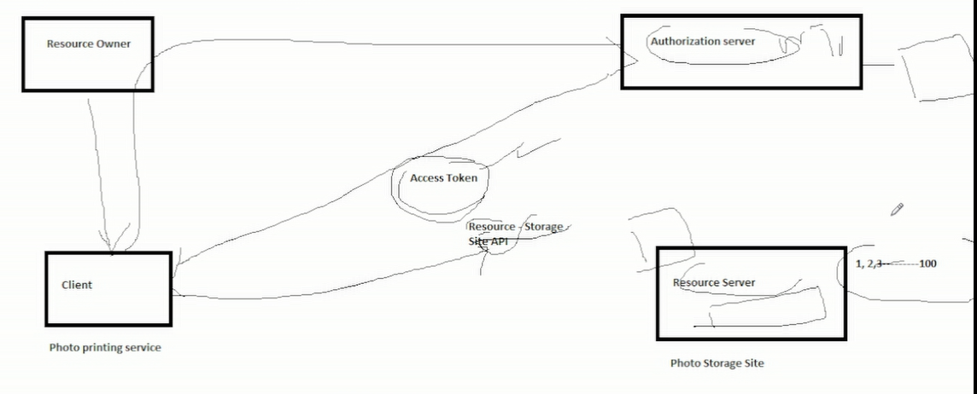
In our printing example, the photo-printing service can ask the user. “Do you have any of your photos stored on the storage site? If so, we can totally print that.” The user is then sent to the photo storage service, which asks, “This printing service is asking to get some of your photos ; do you want that to happen? The user can then decide whether they want that to happen, deciding whether to delegate access to the printing service.
The distinction between an delegation and an authorization protocol is important here because the authorizations being carried by the Oauth token are opaque to most of the system. Only the protected resource needs to kow the authorization, and as long as it’s able to find out from the token and its presentation context ( either by looking at the token directly or by using a service of some type to obtain this information), it can serve the API as required.

